Slide 1
Lab 2: Exploring Data with Graphical Displays and Numerical Summaries
As you enter room:
* Find your name on the sign in sheet.
Sign In by your Name
Find the Table you were randomly assigned.
** Sit at any of the seats and the table you were assigned.
*** Get a handout – next to the sign in sheet.

Slide 2
Concepts Needed for Lab 2
Types of Variables:
Discrete Quantitative – results are numbers that represent a count (“the number of …”).
Continuous Quantitative – results are numbers that represent a measurement.
Categorical – numbers that are not counts or measurements and anything that is not a number.
Graphical Displays and Numerical Summaries:
To determine which graphical displays and numerical summaries are appropriate for a variable reference Table 2.1 on page 10.

Slide 3
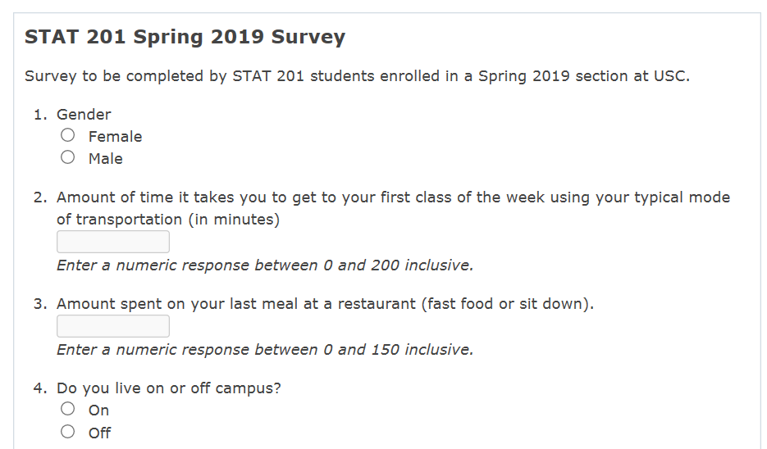
Data Collection for Lab 2
https://www.bls.gov/oes/additional.htm

Slide 4
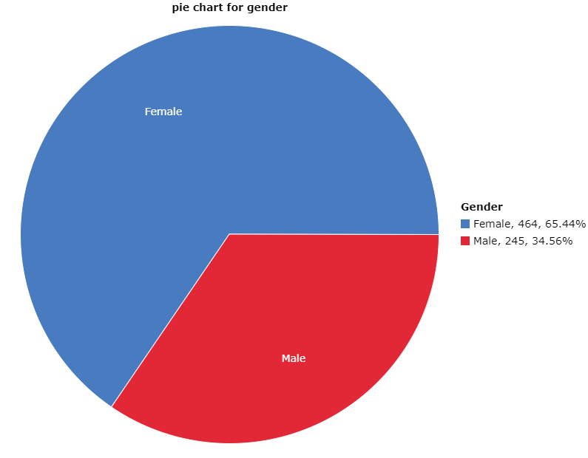
Categorical vs Quantitative Review
1. Categorical variables:
Yes/no response, gender, etc.
Each observation belongs to one of a set of distinct categories.
Students who take Fall 2018 STAT 201:

Slide 5
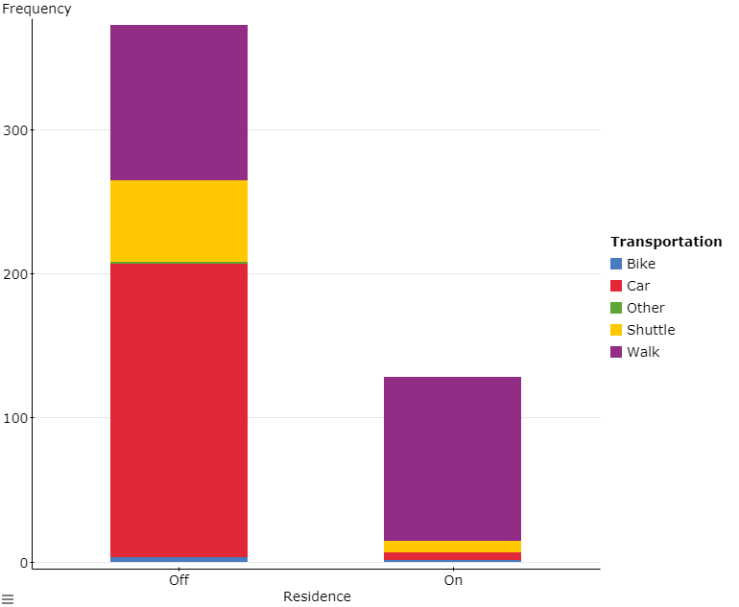
Students who take Fall 2018 STAT 201:

Slide 6
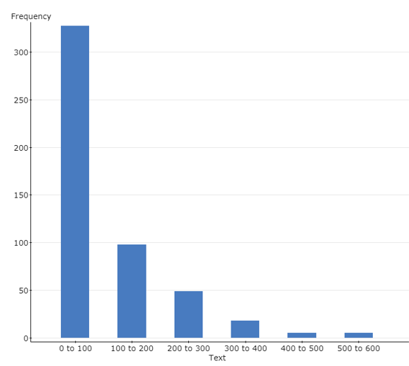

2. Quantitative variables:
Observations take on numerical values that represent different magnitudes of the variable.
Age, income, number of siblings.
How many text messages do you send per day?
For Students who take STAT 201:

Slide 7
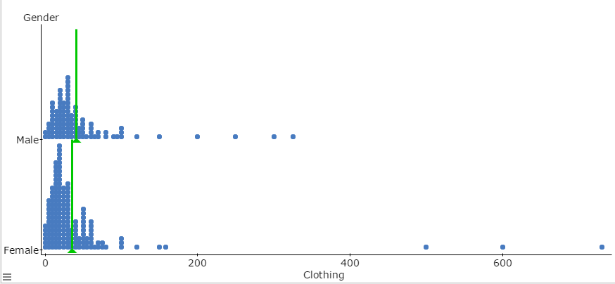
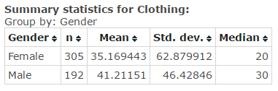
How much does students spent on clothing

Slide 8
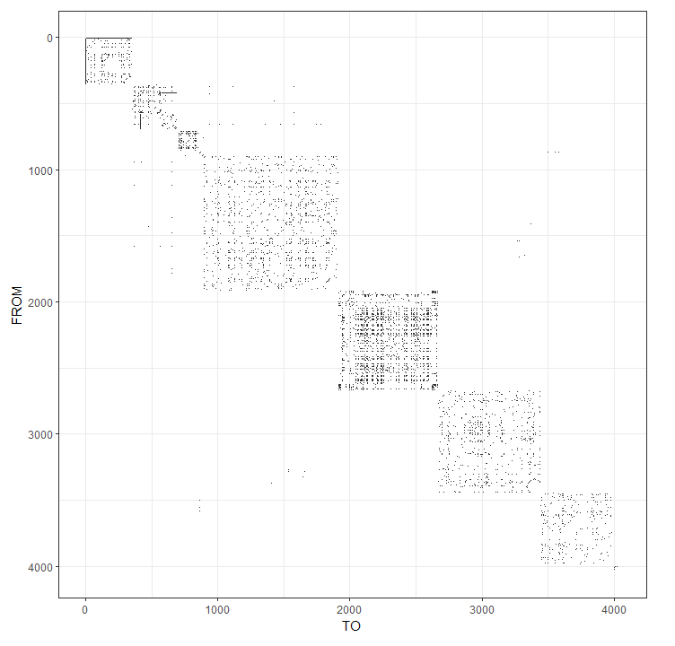
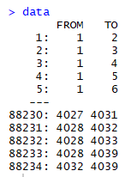
This dataset consists of 'circles' (or 'friends lists') for anonymized 10 people from Facebook

Slide 9
Accessing the Survey Data for Analysis
Logon to a computer:
Work in pairs on the computers in the room (must work with someone from your table).
You may use a laptop; however, you will have to print so at some point you are going to have to get on a computer in the room.
Log onto StatCrunch.com:
www.statcrunch.com
Sign in using your MyStatLab ID and password.
Navigate to the survey dataset created:
Click Explore
Select Data
Type in Name of Dataset in Browse all Search field on left side of screen (type it carefully):
Responses to STAT 201 Fall 2018 Survey – End of Semester
Note if you type it differently at all it will not find the dataset. You may search for a smaller part STAT 201 Spring 2019 and a few options may appear.
Select the correct dataset. When you click on the correct file a spreadsheet should open that contains many rows with responses.
Start Answering the questions on pages 13 and 14 of the lab book.

Slide 10
Before you Leave
Turn in pages 13 and 14 from the lab book and the Word document you created with graphs, numerical summaries, and observations. Everyone needs to turn in their own work.
Make sure to fill in Table 2.2.
Reference table 2.1 on page 10 for what graphs and numerical summaries are appropriate.
For Numerical Summaries look under Summary Stats and Tables.
When working with Two Variables (#3 and #4) make sure your graphs have all information on one graph (use the Group by option).
Register for MyStatLab if you haven’t already. If you haven’t already done so make sure you do Pre-Lab Introduction and Pre-Lab 2 as they are due now.

